Slide 1

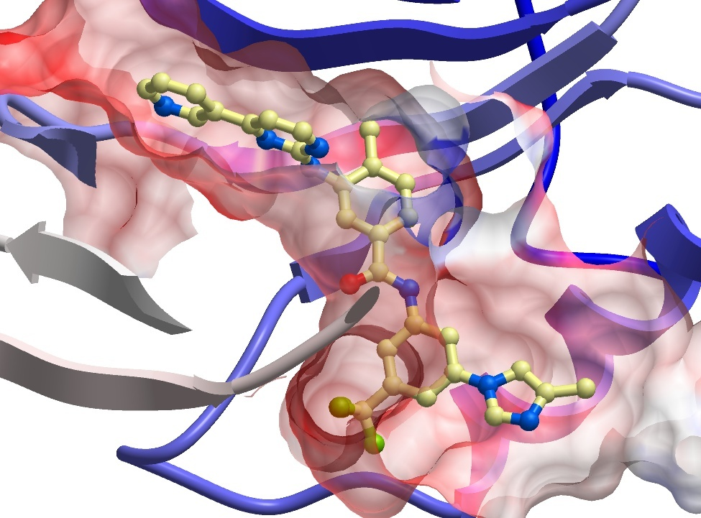






AViDD Collaboration:
Solubility Test of 15 compounds by DLS
Fengling Li
SGC Toronto
March 12th, 2025
SGC Frankfurt
SGC KI
SGC Neuro
SGC Toronto
SGC UNC

Slide 2
DLS Testing
Solubility of 15 compounds (from Plate AViDDUCL-0044) were tested by DLS (DynaPro DLS Plate Reader III) from 25µM to 100µM, in filtered 20mM Tris pH 7.5, 1mM MgCl₂, 2mM MnCl₂, 0.003% Triton X-100, 2% DMSO, at 25ºC.
Buffer with 2% DMSO control produced laser power of 100%.
The compounds are ranked according to increasing intensity values at 100µM.
Compound Name | ChemiReg ID | Normalized Intensity (kCnt/s) |  |  | Laser Power (%)
 |  | 25µM | 50µM | 100µM | 25µM | 50µM | 100µM
RD000290b | RA-0025381-01 | 695 | 1823 | 394 | 100 | 95 | 100
RD000403a | RA-0189002-02 | 642 | 1736 | 515 | 100 | 95 | 100
BD007353e | RA-0010874-03 | 605 | 2413 | 544 | 100 | 85 | 100
RD000404a | RA-0205180-01 | 946 | 1166 | 2615 | 100 | 85 | 50
RD000291b | RA-0025384-01 | 2579 | 1964 | 3514 | 90 | 90 | 50
RD000407a | RA-0205340-01 | 2168 | 2262 | 3778 | 80 | 85 | 40
RD000400a | RA-0189049-02 | 3090 | 4208 | 4290 | 55 | 40 | 35
RD000408a | RA-0205341-01 | 2379 | 3030 | 5025 | 75 | 60 | 45
RD000405a | RA-0205185-01 | 2361 | 3424 | 5195 | 60 | 40 | 35
RD000410a | RA-0205445-01 | 2777 | 2272 | 6262 | 75 | 75 | 55
RD000406a | RA-0188454-03 | 2528 | 14052 | 8009 | 65 | 10 | 15
RD000399a | RA-0189047-02 | 1430 | 3071 | 16003 | 75 | 30 | 15
RD000409a | RA-0205441-01 | 5525 | 19252 | 19318 | 60 | 25 | 20
RD000401a | RA-0204957-01 | 22134 | 35701 | 19657 | 10 | 10 | 10
RD000402a | RA-0012822-03 | 7286 | 8744 | 21466 | 50 | 30 | 15

Slide 3

ACKNOWLEDGEMENTS
Chief Scientist: Cheryl Arrowsmith
Project manager: Peter J. Brown
Experiments in this report were performed by:
Fengling Li
Protein Purification:
Elisa Gibson
Compound Management:
Albina Bolotokova
www.thesgc.org
FUNDING PARTNERS
The Structural Genomics Consortium is a registered charity (no: 1097737) that receives funds from Bayer AG, Boehringer Ingelheim, Bristol Myers Squibb, Genentech, Genome Canada through Ontario Genomics Institute [OGI-196], EU/EFPIA/OICR/McGill/KTH/Diamond Innovative Medicines Initiative 2 Joint Undertaking [EUbOPEN grant 875510], Janssen, Merck KGaA (aka EMD in Canada and US), Pfizer and Takeda.

